Slide 1
“Support to the Ministry of Infrastructure for the Ukraine Urban Public Transport Framework Loan Project”
Kick-off meeting
Institutional arrangements
Kiev, 13th December 2016

Slide 2
“Support to the Ministry of Infrastructure for the Ukraine Urban Public Transport Framework Loan Project”
Table of contents
1 Institutional arrangement
1.1 Steering Committee
1.1.1 Purpose
1.1.2 Composition
1.1.3 Functions
1.2 PMSU
1.2.1 Purpose
1.2.2 Composition
1.2.3 Functions
1.3 PIU
1.3.1 Purpose
1.3.2 Composition
1.3.3 Functions
2 Organisational set-up
2.1 General
2.2 Chart

Slide 3
“Support to the Ministry of Infrastructure for the Ukraine Urban Public Transport Framework Loan Project”
1.1 Steering Committee
1.1.1 Purpose
For the proper implementation of the Urban Public Transport Project (UPTP) supported by the EIB and other IFIs, and to ensure the Beneficiaries` ownership, a Steering Committee (SC) must be set-up before the beginning of the UPTP implementation phase.
This SC will be responsible for high level Project and sub-projects endorsement and supervision to ensure that progress is being made towards achieving the Project goals and objectives set in the Financing Contract between EIB and Ukraine.
The SC will be supported in its role and functions by the Project Management and Support Unit (PMSU) that will serve as the Secretariat of the Steering Committee, prepare briefing papers and progress reports and provide all the necessary information and evidence the Steering Committee needs to make informed decisions.

Slide 4
“Support to the Ministry of Infrastructure for the Ukraine Urban Public Transport Framework Loan Project”
1.1.2 Composition
The SC will have members from the following stakeholders:
Ministry of Infrastructure, who will chair the SC;
Ministry of Finances;
PMSU, and
other stakeholders, where appropriate and subject to the prior agreement of the MIU and EIB.
EIB will have an observer status in the SC.
The composition of the SC as well as the changes of its members shall be approved by the MIU , in consultation with EIB.

Slide 5
“Support to the Ministry of Infrastructure for the Ukraine Urban Public Transport Framework Loan Project”
1.1.3 Functions
The Steering Committee will:
- authorize the launch of the Project, then meet on a quarterly basis thereafter. In addition to these regular meetings the SC can meet upon request of its members and main stakeholders;
resolve strategic issues (i.e. those which may impact the success of the Project);
endorse the UPTP mandate to make strategic recommendations on the Project procedures, including approving the Project Procedures Manual (PPM) and approve the modification in this PPM if it has to be amended;
support the UPTP implementation through top-level commitment to provide and maintain resources required for the UPTP implementation;
endorse eligible Sub-Project proposals submitted by the PMSU during the screening phase;

Slide 6
“Support to the Ministry of Infrastructure for the Ukraine Urban Public Transport Framework Loan Project”
1.1.3 Functions (continued)
Endorse sub-projects Loan Fund Transfer Agreement submitted by the PMSU with counter signature of all its Members;
facilitate and review the functioning of the PMSU and the progress of works under the UPTP;
Monitor and facilitate efforts made to secure funding, including investment grants;
Monitor Project and sub-projects progress and budgets;
Authorising closure of the UPT-EIB financed Project.
The SC will be supported by the PMSU which will prepare the meetings, draft agendas and minutes.

Slide 7
“Support to the Ministry of Infrastructure for the Ukraine Urban Public Transport Framework Loan Project”
1.2 Project Management and Support Unit (PMSU)
1.2.1 Purpose
The Financing Contract forecast that EIB could finance up to 20 cities transport projects, for supplies (e.g. rolling stock), transport infrastructure works, and services for a total possible amount of € 200 million, subject to a co-financing of an equal amount as well as general and specific conditions.
This large and extended geographical scope implied a coordinating unit, with a managing and supporting role, at the central level, namely the PMSU.
The PMSU will then ensure the overall UPTP coordination, monitoring and reporting.

Slide 8
“Support to the Ministry of Infrastructure for the Ukraine Urban Public Transport Framework Loan Project”
1.2 PMSU
1.2.2 Composition
The staff of the PMSU will consist of the MIU and other Ministries employees from relevant departments.
The PMSU will consist, but not necessarily be limited to, the following full time staff: Project Manager, procurement specialist, engineer(s), environment and social safeguards specialist, monitoring and evaluation specialist, financial management specialist, accountant and assistant. Other staff can be involved on short and medium-term basis as needed.
The degree of involvement of staff may be discussed during the start-up period.
The PMSU will be supported by Technical Assistance on a permanent and where relevant ad-hoc basis.

Slide 9
“Support to the Ministry of Infrastructure for the Ukraine Urban Public Transport Framework Loan Project”
1.2 PMSU
1.2.3 Functions
The PMSU will be responsible:
for UPTP implementation related activities, of the proper use of agreed procedures for disbursements, procurement, financial management, environmental and social safeguards, assistance in UPTP coordination and general monitoring of the implementation on day-to-day basis, and
for support to the PIUs in implementation of the sub-projects in procurement, financial management, and other aspects to the extent required, in communication with EIB;
For supporting the SC functioning and providing in due time the necessary information for substantiated SC decisions.

Slide 10
“Support to the Ministry of Infrastructure for the Ukraine Urban Public Transport Framework Loan Project”
1.3 PIU (sub-Project Implementation Unit)
1.3.1 Purpose
The planning, preparation and implementation of a sub-project rely on the Final Beneficiary (Municipality(ies) or Municipality(ies) transport company).
The past experience has consistently demonstrated that the best way to ensure a proper planning, preparation and implementation of these transport (sub) projects is for the final Beneficiary to set-up an ad-hoc dedicated structure, a PIU, that will be in charge of the sub-project success on his behalf and under his control;
A PIU must be then created by each Final Beneficiary (City or municipal transport company) for the sub-project to be eligible for financing by the EIB.

Slide 11
“Support to the Ministry of Infrastructure for the Ukraine Urban Public Transport Framework Loan Project”
1.3 PIU (sub-Project Implementation Unit)
1.3.2 Composition
A PIU will generally consist of:
a sub-project manager/coordinator, a procurement specialist(s), sector engineer(s), and a financial management specialist. For large sub-projects these experts are expected to dedicate 100% of their time to the PIU and sub-projects. The Final Beneficiary PIU at its own discretion may involve other personnel in the PIU as needed taking into account the volume and nature of tasks set before the PIU. For large sub-project(s), the PIU may be supported by a separate external consultant team funded with TA funds coming from donors, or from loan proceeds.
The Final Beneficiary will determine the most suitable and operational PIU structure and staffing to match the sub-project needs.

Slide 12
“Support to the Ministry of Infrastructure for the Ukraine Urban Public Transport Framework Loan Project”
1.3 PIU
1.3.3 Functions
The PIUs will be responsible for:
preparation of sub-project documentation, of technical specifications and tender documents, service contracts,
leading procurement process according to the EIB Guide to Procurement (GtP), financial/accounting management,
monitoring of physical works, environmental and social assessment requirements, monitoring and evaluation, and
preparation of progress and completion reports for sub-projects.
The PIUs will be supported in these tasks by experts from PMSU and where relevant by TA.

Slide 13
“Support to the Ministry of Infrastructure for the Ukraine Urban Public Transport Framework Loan Project” 2 Institutional set-up 2.1 General

Slide 14
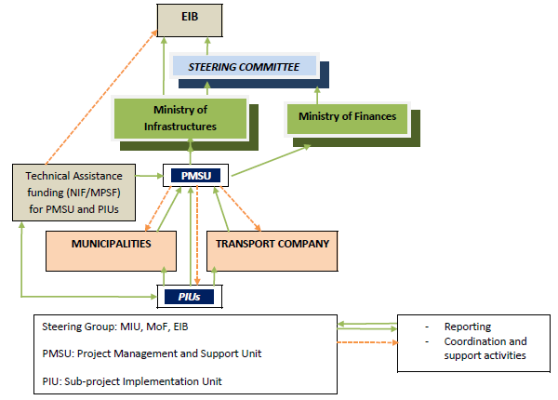
“Support to the Ministry of Infrastructure for the Ukraine Urban Public Transport Framework Loan Project” 2.2 Chart

Slide 15
“Support to the Ministry of Infrastructure for the Ukraine Urban Public Transport Framework Loan Project”
Questions and discussion

Slide 16
“Support to the Ministry of Infrastructure for the Ukraine Urban Public Transport Framework Loan Project”
THANK YOU

