Slide 1
“Support to the Ministry of Infrastructure for the Ukraine Urban Public Transport Framework Loan Project”
Kick-off meeting
The (sub) Projects Implementation Units (PIU)
Kiev, 13th December 2016

Slide 2
“Support to the Ministry of Infrastructure for the Ukraine Urban Public Transport Framework Loan Project”
Table of contents
1 Preparation of sub-projects
1.1 TEO/Feasibility Study (FS) and Cost Benefit Analysis (CBA)
1.2 Environment and Social Impact Assessment (ESIA)
1.3 Procurement strategy
1.4 Procurement plan
1.5 Questions and discussion
2 Implementation of sub-projects
2.1 Thresholds for International and National bidding
2.2 PMSU and EIB supervision during the tendering process
2.3 Reporting and monitoring requirements – form and timing
2.4 Questions/discussion

Slide 3
“Support to the Ministry of Infrastructure for the Ukraine Urban Public Transport Framework Loan Project”
Table of contents (continued)
2.5 Type of contracts
2.5.1 Works
2.5.2 Services
2.5.3 Supplies
2.5.4 Implementation after contracting
2.6 Procedures for payment of contractors (``Fund allocation request``)
2.7 Accounting
2.8 Staffing
2.9 Communication
3 Project completion
3.1 Project completion report
3.2 Update of monitoring indicators
4 Questions/discussion

Slide 4
“Support to the Ministry of Infrastructure for the Ukraine Urban Public Transport Framework Loan Project”
1 Preparation of sub-projects
1.1 ТЭО/Feasibility Study (FS) and Cost Benefit Analysis (CBA)
A feasibility study is defined in the Cambridge dictionary as ``an examination of a situation to decide if a suggested method, plan, or piece of work is possible or reasonable``.
It is the basis for determining the need for financial investments.
If a system/investment is economically, financially and socially feasible, then the benefits should outweigh the costs within a defined period of time acceptable to the borrower and to the lender, if external financing is required.

Slide 5
“Support to the Ministry of Infrastructure for the Ukraine Urban Public Transport Framework Loan Project”
In order to do a thorough cost-benefit analysis, are needed:
1) Development/investment Costs of the sub project;
2) Annual Operating Costs (VOC most often in the transport sector);
3) Annual revenues and benefits;
4) Economic life of the item in the system (10 ?, 15 ?, 20 ? years)
5) Required rate of return including subsidies/compensation by the City council.
Example:
The planned investment costs € 1 million to develop and implement and reduces costs and/or increases revenues by € 100,000 annually. Payback period is € 1 million/ €100,000 = 10 years; Net present value and Internal rate of return, are used as well for CBA.
In the UPTP, others factors are to be taken into account (social and environment benefits, decreased fuel costs if more public transport passengers, others). For detailed info and EU guideline for CBA:
http://ec.europa.eu/regional_policy/sources/docgener/studies/pdf/cba_guide.pdf

Slide 6
“Support to the Ministry of Infrastructure for the Ukraine Urban Public Transport Framework Loan Project”
1.2 Environmental and Social Impact Assessment (ESIA)
Each sub-project:
- must comply with the international conventions Ukraine is part of, e.g. For environment issues, the Convention on Access to Information, Participation of Public in the Process of Decision-making and Access to Justice (Aarhus Convention) following minimum requirements with respect to environmental legislation and information access:
- shall be carried out in accordance with the basic principles of Directives 79/409/EC (Birds); 85/337/EC (Environmental Impact Assessment) as amended; 92/43/EC (Habitats), 96/11/EC (IPPC) and 2001/80/EC (Large Combustion Plants) where applicable and of the EIB Environmental and Social Standards (http://www.eib.org/attachments/strategies/environmental_and_social_practices_handbook_en.pdf)

Slide 7
“Support to the Ministry of Infrastructure for the Ukraine Urban Public Transport Framework Loan Project”
1.2 Environmental and Social Impact Assessment (ESIA)
Based on these requirements, the Final Beneficiary shall undertake an Environmental Impact Assessment (EIA) for the sub-projects selected under the UPTP, that add to the existing environmental situation (such as for instance the extension of tramway lines, construction of new depots, stations) in line with international conventions of which Ukraine is part of and the principles of the Directive 2001/42/EC.
In case of rehabilitation of existing infrastructure (tramway railroads, overhead lines for trolleybuses, depots) environment and social mitigations measures should be prepared for the renovation work period.
For each Sub-Project with potential or likely impact on a site of nature conservation importance that is protected under national legislation or international agreements, documentary evidence in the Bank’s standard forms and satisfactory to the Bank of the opinion of the competent national authority for nature conservation that no part of the proposed Sub-Project will have a significant negative impact on the site on which the Sub-Project will be carried out.

Slide 8
“Support to the Ministry of Infrastructure for the Ukraine Urban Public Transport Framework Loan Project”
1.3 Procurement Strategy
The purpose of identifying and selecting an appropriate procurement strategy is to find the best way to obtain the solution/result to satisfy the needs of the end user(s) for goods, works and services by obtaining the most advantageous pricing and contractual conditions through a competitive process that will best deliver what is required in a timely manner.
A procurement strategy includes notably:
- choice of the type of arrangement and/or contract to be concluded;
-choice of the procurement method;
type of competition to be adopted to purchase the required supplies/services/works.
To select a procurement strategy, the procurement officer will have to consider factors such as the EIB procurement procedures, financial thresholds, the type of procurement (goods, services or works), the complexity or the specificity of a requirement, and the market conditions.

Slide 9
“Support to the Ministry of Infrastructure for the Ukraine Urban Public Transport Framework Loan Project”
1.4 Procurement plan
Under UPTP all procurement procedures and contracts related to individual sub-projects will be reflected in a procurement plan prepared by the respective PIU for each sub-project. Consolidation of procurement plans in one joint procurement plan for a sub-project is done by the PMSU and submitted to EIB for review and approval (no objection). An example is given below:

Slide 10
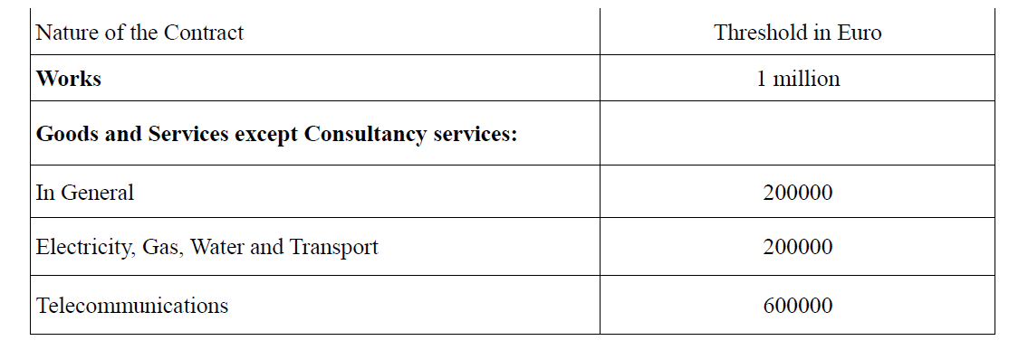
“Support to the Ministry of Infrastructure for the Ukraine Urban Public Transport Framework Loan Project”
2 Implementation of sub projects
2.1 Thresholds for International and National bidding
A distinction is made between National Competitive Bidding (NCB) and International Competitive Bidding (ICB). Application of NCB or ICB procurement procedures depends on the type of contract (service, works, and supply) as well as on the value of contract. The thresholds for ICB procurement under UPTP are indicated in the table below.

Slide 11
“Support to the Ministry of Infrastructure for the Ukraine Urban Public Transport Framework Loan Project”
2 Implementation of sub projects
2.1 Thresholds for International and National bidding
Thresholds for Technical Assistance

Slide 12
“Support to the Ministry of Infrastructure for the Ukraine Urban Public Transport Framework Loan Project”
2 Implementation of sub-projects
2.2 PMSU and EIB supervision during the tendering process
All procurement under UPTP shall be carried out in compliance with the EIB Guide to Procurement for projects financed by the EIB.
The procurement procedure is confidential. Confidentiality enables the PIU to prevent any inadmissible interference. The PIU and Evaluation Committee can therefore not share any information on the evaluation of bids nor make any award recommendation to the bidders or to any other persons who are not officially involved in the procurement procedure. In the case of breach of confidentiality, the PMSU or EIB/IFIs may demand cancellation of the tender procedure.
Any attempt by a bidder to influence the process in any way (whether by initiating contact with members of the Evaluation Committee or otherwise) will result in the immediate exclusion of the tender from further consideration.

Slide 13
“Support to the Ministry of Infrastructure for the Ukraine Urban Public Transport Framework Loan Project”
2 Implementation of sub-projects
2.2 PMSU and EIB supervision during the tendering process
Bids that are not rejected are evaluated by an Evaluation Committee, nominated by the Employer (Final Beneficiary, Transport company) and reviewed by the PMSU. In case of disagreement the issue shall be brought to the EIB who has the right to object.
The PMSU and/or the EIB may nominate an observer to follow the evaluation. Each Final Beneficiary and its PIU shall then permit independent observers to visit its premises during all stages of tendering; and grant the right of the Bank in connection with the tendering of each Sub-Project:
- to review the evaluation reports prior to their approval by the relevant evaluation committees; and
- to prescribe the venue of the tender evaluations and the manner of the receipt and storage of the bids;
EIB reserves the right to review the bids of all bidders or of specific bidders as well as all other documents in connection with the procurement process and awarded up to two years after completion of the project.

Slide 14
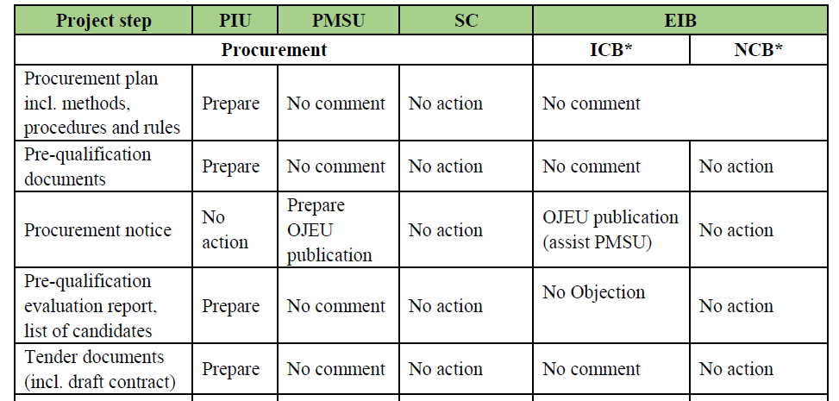
“Support to the Ministry of Infrastructure for the Ukraine Urban Public Transport Framework Loan Project”
2 Implementation of sub-projects
2.2 PMSU and EIB supervision during the tendering process (continued)
The Evaluation Reports and award recommendation shall be submitted to the PMSU. For the larger sub-projects, reports shall be submitted to EIB in time to permit a review and reply to the promoter (City Council or City transport company).

Slide 15
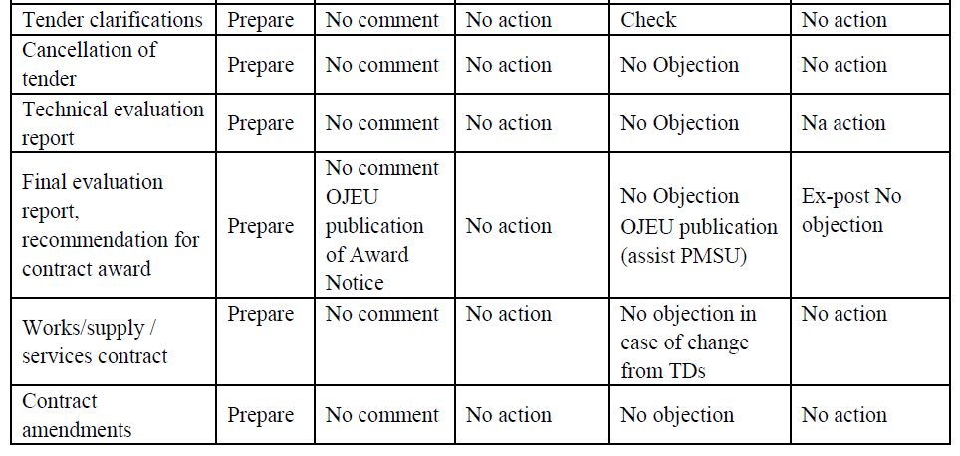
“Support to the Ministry of Infrastructure for the Ukraine Urban Public Transport Framework Loan Project”
2 Implementation of sub-projects
2.2 PMSU and EIB supervision during the tendering process (continued)

Slide 16
“Support to the Ministry of Infrastructure for the Ukraine Urban Public Transport Framework Loan Project”
2.3 Reporting and monitoring requirements – form and timing
2.3.1 UPTP Reporting
UPTP progress reports are to be submitted semi annually, with the first report to be submitted 6 months from the signature of the finance contract. These progress reports should content the following:
A brief update on the allocation process, explaining the reasons for significant changes vs. initial scope;
A brief update on the effectiveness of technical assistance and identification of further technical assistance requirements;
Update on the date of completion of each of the main sub-projects, explaining reasons for any possible delay;
Update on the costs of the sub-projects, explaining reasons for any possible cost variations vs. initial budgeted cost;
A description of any major issue with social or environmental impacts;
Update on procurement procedures;
Comment on any significant issues or risks that may affect the Project and sub-projects’ operation, including any on-going or forecast legal action;.

Slide 17
“Support to the Ministry of Infrastructure for the Ukraine Urban Public Transport Framework Loan Project”
2.3 Reporting and monitoring requirements – form and timing
2.3.2 UPTP Monitoring (continued)
EIB should receive from the PMSU and/or the MoF, in addition to the documentation specified in the Finance Contract reporting section, any document reasonably requested by EIB, including, but not limited to, audit reports or accounting statements for each of the sub-projects and for the aggregated UPTP figures.
The financial monitoring tasks in relation to this program consist in:
Lending Operation support:
- Contractual compliance review;
- Security and collateral monitoring.
Contractual Follow up:
- Guarantee renewals;
- Waivers and amendments;
- Disbursements;
- Revisions and conversions;
- Voluntary repayments.

Slide 18
“Support to the Ministry of Infrastructure for the Ukraine Urban Public Transport Framework Loan Project”
2.3.3 Sub-projects reporting
The PIUs are responsible for drafting and presenting quarterly reports to the PMSU and EIB/IFIs. The basic PIU reporting requirements are presented below:
Quarterly Progress Report:
- that is to be submitted to the PMSU and Contracting Authority/Final Beneficiary. The report presents the activities carried out in the previous quarter by the PIU, including report on sub-project progress, publicity activities and actions, risks, problems etc.;
Quarterly Financial Report:
-That contains a summary of the financial status of the sub-project compared to budget and cash flow predictions. To be submitted to the PMSU and Contracting Authority/Final Beneficiary.
PIUs shall submit these quarterly progress and financial reports within 30 days after the end of each quarter. In addition the PIU must prepare and submit any reasonable reports requested by other parties involved in the sub-project.

Slide 19
“Support to the Ministry of Infrastructure for the Ukraine Urban Public Transport Framework Loan Project”
2.3.4 Sub-projects monitoring
The progress of sub-projects implementation has to be subject to constant monitoring by the respective PIUs or their consultant, with regular reporting of progress and issues to the PMSU.
This continuous monitoring shall be conducted based on the Quarterly Progress Reports, the format and table of contents to be agreed with the Employer (as given in the contract, i.e. city or cities communities and/or city/cities public transport companies).
The respective PIUs act on behalf of the Employer and are responsible for monitoring project progress and the engineering consultants’ and contractors’ compliance with the terms of their respective contract.
Through conducting continuous progress monitoring the PIUs shall ensure that the Employer’s requirements / technical specifications and that milestones according to the contracts are met.

Slide 20
“Support to the Ministry of Infrastructure for the Ukraine Urban Public Transport Framework Loan Project”
2.3.4 Sub-projects monitoring (continued)
EIB will hire verification experts that will carry out sample checks at different stages in the sub-project implementation process. The PIU will ensure that appropriate access to any site and any document required for carrying out the verification is granted to the experts upon their request. The verification may concern, but shall not be limited to the following elements:
Compliance of the scope of works with recommendations of preparatory studies.
Quality of technical designs;
Quality of infrastructure construction works;
Quality of rolling stock used;
Quality of services with the use of purchased Rolling stock;
Ensuring that PSC, if contracted, is conveniently implemented;
Ex-post verification of sub-project results;
Procurement;

Slide 21
“Support to the Ministry of Infrastructure for the Ukraine Urban Public Transport Framework Loan Project”
2.3.4 Sub-projects monitoring (continued)
Reporting on and fulfilment of financial and operational targets.
PIUs will permit persons designated by the Bank, who may be accompanied by representatives of the European Court of Auditors, the European Commission and the European Anti-Fraud Office, to:
visit the sites, installations and works comprising the Project and to conduct such checks as they may wish for purposes connected with this Contract and the financing of the Project,
interview PIU staff and not obstruct contacts with any other person involved in or affected by the sub-project

Slide 22
“Support to the Ministry of Infrastructure for the Ukraine Urban Public Transport Framework Loan Project”
2.4 Questions and discussion

Slide 23
“Support to the Ministry of Infrastructure for the Ukraine Urban Public Transport Framework Loan Project”
2.5 Type of contracts
2.5.1 Works
The PIUs or their consultant (contractor) are responsible for preparing design and tender documents. If a consultant is employed, the PIUs will primarily be responsible for supplying the required information, supervising the consultants’ work and reviewing and approving their outputs.
Tender documents for works shall be prepared using internationally recognised standard procurement documentation, such as:
the World Bank templates (2015 Procurement of Works and User's Guide),
the PRAG (Practical Guide to contract procedures for European Union external actions), or
the FIDIC (Fédération Internationale des Ingénieurs-Conseils) documents that can be ordered at the FIDIC website (www.fidic.org)

Slide 24
“Support to the Ministry of Infrastructure for the Ukraine Urban Public Transport Framework Loan Project”
2.5 Type of contracts
2.5.1 Works (continued)
In any case, the tender documents must be compatible with the provisions of the EIB Guide to Procurement.
These tender documents must be drafted in such a way as to permit wide international competition (if amount is superior to € 1 Million) and national competition (if inferior to € 1 Million).
The tender documents, as well as procurement notices and pre-qualification documents, if applicable, should all be drawn up in English for ICB tenders, while Ukrainian can be used for NCB tenders.
After approval of design and tender documents by the PIU, they should be submitted to the PMSU for review.
Internationally and nationally tendered contracts with a value above € 350, 000, require a tender for a position of a “Project Engineer”. The Project Engineer shall be a responsible and suitably qualified engineer with a minimum of 10-15 years’ experience supervising works of a similar nature.

Slide 25
“Support to the Ministry of Infrastructure for the Ukraine Urban Public Transport Framework Loan Project”
2.5 Type of contracts
2.5.1 Works (continued)
The terms of reference for this ``Project Engineer`` should be drafted with the assumption that the PIU shall in general not approach directly the Contractor. This is the task of the Engineer who should:
Approve all changes and variations;
Assume the takeover of structures, equipment and supplies on behalf of Employer;
Review Contractor reports;
Provide statements on Contractor´s requests;
Prepare statements on design author supervision, which should be arranged and paid for by the Employer for FIDIC Red Book contracts and by the contractor for FIDIC Yellow Book contracts;
Elaborate statements on technical issues during construction, statements on irregularities and defects in designs;

Slide 26
“Support to the Ministry of Infrastructure for the Ukraine Urban Public Transport Framework Loan Project”
2.5 Type of contracts
2.5.1 Works (continued)
Prepare reports on unforeseen technical problems, on complaints from public and on their requests;
Monitor the safety issues on site and minimization of negative effects of works on environment and surroundings;
Approve extra works and significant changes in the project subject to substantiated justifications.
Sub-project supervision is the responsibility of the consultant retained for this purpose for the sub-project quality assurance and quality control. The consultant acts on behalf of the Final Beneficiary and in accordance with the contract conditions.
General and site supervision of works shall be performed on a continuous basis. Permanent presence on site by the consultant should be provided during all on-going construction and installation work.

Slide 27
“Support to the Ministry of Infrastructure for the Ukraine Urban Public Transport Framework Loan Project”
2.5 Type of contracts
2.5.1 Works (continued)
In summary, the sub-project supervision for works contracts includes the following activities:
Preparation of initial operation activities;
General and site supervision of works and construction management;
Continuous project management and monitoring (site diary);
Periodic reporting;
Participation in the preliminary acceptance; and
Compilation of the sub-project Final Report.
The exact scope of the sub-project supervision services the engineering consultant has to conduct is defined in detail in the Terms of Reference of the consulting contract.

Slide 28
“Support to the Ministry of Infrastructure for the Ukraine Urban Public Transport Framework Loan Project”
2.5.2 Supplies
In the UPTP framework, it will be rolling stock, new or rehabilitated, and related support equipment. If the amount is more than € 200,000 the tender is international and open, with publication in the EU Official Journal. It is subject to National competitive bidding if the total amount is less than € 200, 000.
Well written technical specifications (TS) are key to any successful tender, and obviously for supplies.
Unclear, unnecessarily detailed and biased specifications will decrease the number of suppliers participating the tender and reduce the quality and value for money.
Unclear specifications will as well confuse bidders, which may cause rejection of bids. This may entail the rejection of all bids and rescheduling of the tender with consequent time delays.
Technical Assistance will be available when relevant and requested for supporting the writing of TS.

Slide 29
“Support to the Ministry of Infrastructure for the Ukraine Urban Public Transport Framework Loan Project”
2.5.3 Services
Short term TA services will be available following Beneficiaries request for each sub-project or package of sub-projects preparation and implementation, subject to the prior approval of the PMSU and EIB (Terms of reference, tender procedure and contracting, monitoring).
Above € 200,000, an ICB open or restricted procedure apply. Between € 50,000 - € 200,000 request 3 to 7 candidates with at least among them 2 different nationalities. For contract less than € 50 000 amount, 1 candidate is allowed.
The following topics are eligible:
Project appraisal;
Technical specifications;
Tender procedure support;
Works and contracts implementation monitoring;
Monitoring and evaluation.

Slide 30
“Support to the Ministry of Infrastructure for the Ukraine Urban Public Transport Framework Loan Project”
2.5.4 Implementation after contracting
After conclusion of a contract the main sub-project implementation tasks for the PIU and, where applicable, their consultants are listed below:
Supervise the construction and commission the works;
Accept the goods;
Supervise their entry into operation and use;
Report on possible un forecast technical issues;
Monitoring during the defects liability period;
Evaluate the work performed and monitor on a weekly basis the overall sub-project implementation status.
For sub-projects where the size and complexity so justify, UPTP loan proceeds will be available for PIU to procure consultants to assist with the project implementation phase.

Slide 31
“Support to the Ministry of Infrastructure for the Ukraine Urban Public Transport Framework Loan Project”
2.6 Procedures for Payment of contractors (``Fund allocation request``)
The conditions that must be met prior to allocation of EIB’s funds to a sub-project under the UPTP are the following:
Sub-projects must be approved by the PMSU and endorsed by the Steering Committee;
Participating promoters (City Council or City transport company) need to establish and adequately staff a sub-Project Implementation Unit (PIU);
Sufficient information on the sub-project is provided to enable EIB to carry out its due diligence;
If necessary, Technical Assistance (TA) for supporting the sub-project implementation must be available and a sufficient budget must be reserved for it.

Slide 32
“Support to the Ministry of Infrastructure for the Ukraine Urban Public Transport Framework Loan Project”
2.6 Procedures for Payment of contractors (``Fund allocation request``)
Sub-projects that complete the preparation phase will need to be approved by the Steering Committee and the EIB for the signature of the Loan Fund Transfer Agreement. The Loan Fund Transfer Agreement shall be co-signed by up to 5 parties: Final Beneficiary, sub-project promoter, MoI, MoF or others as agreed by EIB.
The role of the MoI under this agreement shall be to, except as otherwise agreed by the Bank in writing, upon receiving a request from the Final Beneficiary to do so, recommend measures to establish tariffs at a level that enables each Final Beneficiary to achieve for each fiscal year total operating revenues such that:
a) the sum of total operating revenues and operating subsidies transferred to the Final Beneficiary is not less than,
b) the sum of debt service requirements, including those arising under the Loan Fund Transfer Agreement, and operating expenses.
The MoF shall ensure that sufficient collateral is available under the terms of the agreement from the promoter and/or municipality.

Slide 33
“Support to the Ministry of Infrastructure for the Ukraine Urban Public Transport Framework Loan Project”
2.6 Procedures for Payment of contractors (``Fund allocation request``)
Payments to sub-projects will be made directly from the MoF, according to procedures outlined in the Loan Fund Transfer Agreement, to the consultants, contractors or suppliers following clearance of the invoices by the PIUs and PMSU. Engineering consultants, contractors and suppliers shall issue their invoices in accordance with the progress of the works / deliverables and the contractual stipulations (payment scheme).
The PIUs and, if appropriate, the supervision consultants shall carry out detailed checks of the contractors payment statements and have authority under the contracts to make corrections. The contractor’s certificates of the amounts due to be paid are contractually binding.
•Each invoice shall be tracked by the PMSU through an invoice control system to be established within the PMSU.
The PMSU shall consolidate on a the payments due under sub-Projects and submit them for payment on a weekly basis to MoF together with supporting documents.

Slide 34
“Support to the Ministry of Infrastructure for the Ukraine Urban Public Transport Framework Loan Project”
2.6 Procedures for Payment of contractors EIB verification rights
EIB will hire verification experts that will carry out sample checks at different stages in the sub-project implementation process. The Final Beneficiary will ensure that appropriate access to any site and any document required for carrying out the verification is granted to the experts upon their request. The verification may concern, but shall not be limited to the following elements:
Compliance of the scope of works with recommendations of preparatory studies.
Quality of technical designs;
Quality of infrastructure construction works;
Quality of rolling stock used;
Quality of services with the use of purchased Rolling stock;
Ensuring that PSC, if contracted, is conveniently implemented;
Ex-post verification of sub-project results;
Procurement;
Reporting on and fulfilment of financial and operational targets.

Slide 35
“Support to the Ministry of Infrastructure for the Ukraine Urban Public Transport Framework Loan Project”
2.7 Accounting
Sub-projects accounting records will be maintained by the financial specialist of each PIU for its respective sub-project based on a common standard for all PIUs agreed by the PMSU and the EIB. The accounting records for the sub-project will be maintained on a set of accounts, segregated from other activities of the PIU, in an automated accounting system available at PIU and accessible for audits by the PMSU and EIB at any time.
Sub-projects accounting records will be maintained in accordance with the requirements of National Accounting Standards in national currency (UAH), in the currency of payment and in EUR equivalents.
The language applied in recording financial transactions, reconciliation of accounts and financial reporting shall be bilingual (English and Ukrainian) as the Project is subject to audit and evaluations from EIB.

Slide 36
“Support to the Ministry of Infrastructure for the Ukraine Urban Public Transport Framework Loan Project”
2.8 Staffing
A PIU will generally consist of:
a sub-project manager/coordinator,
a procurement specialist(s),
sector engineer(s), and
a financial management specialist.
For large sub-projects these experts are expected to dedicate 100% of their time to the PIU and sub-projects. The Final Beneficiary PIU at its own discretion may involve other personnel in the PIU as needed taking into account the volume and nature of tasks set before the PIU. For large sub-project(s), the PIU may be supported by a separate external consultant team funded with TA funds coming from donors, or from loan proceeds. It is the responsibility of the Final Beneficiary to determine the most suitable and operational PIU structure and staffing to match the sub-project needs.
Implementation of sub-projects under the UPTP will require appointment of sub-project Managers. This position will generally be fulfilled by the PIU manager or a suitably qualified and experienced member of the PIU staff if justified and agreed by the PMSU.

Slide 37
“Support to the Ministry of Infrastructure for the Ukraine Urban Public Transport Framework Loan Project”
2.9 Communication
A UPTP communication action plan will be prepared by the PMSU and sent to the PIU.
It will include effective public communication channel, e.g. a dedicated web-page of MoI website, press-events forecast during the sub-projects implementation (e.g. use of new rolling stock or infrastructure);
This communication plan should as well promote the institutional/management changes in the public transport such as for instance, the implementation of the Regulation 1370 on public passenger transport services by rail and by road and others.
It will as well underline the best way to use the results of the joint work between the EIB/MoI/Cities (concerned) to progress towards sustainable urban transport in Ukraine

Slide 38
“Support to the Ministry of Infrastructure for the Ukraine Urban Public Transport Framework Loan Project”
3 Project and sub-projects completion
3.1 UPTP Completion and first year of operations
The completion of the Project is expected to be achieved within a 5 years period following the Date of Effectiveness.
A UPTP completion report is to be submitted 15 months after completion of works, supplies delivery and services performed. Content of the report is listed below:
A final description of the allocation process as completed, explaining the reasons for any significant change compared to the initial scope;
The date of completion of each of the sub-projects, explaining reasons for any possible delay;
The final cost of the sub-projects, explaining reasons for any possible cost variations vs. initial budgeted cost;
Employment effects of the sub-projects: person-days required during implementation as well as permanent new jobs created;
A description of any major issue with social or environment impacts;

Slide 39
“Support to the Ministry of Infrastructure for the Ukraine Urban Public Transport Framework Loan Project”
3 Project and sub-projects completion (continued)
Update on the sub-projects’ use;
Update on procurement procedures;
Comments on any significant issue or risk that may affect the UPTP and the sub-project’s operation;
Comments on any legal actions concerning the sub-projects that may be on-going;
Statement about any possible delay, reasons, and remedy actions or recommendations;
Update on the UPTP monitoring indicators
3.2 Update of monitoring indicators
The Borrower (MIU and Final Beneficiaries) shall deliver to the Bank another update on the monitoring indicators, as they were set out in the PPM, at the latest 3 years after the Project’s completion report.
These reports should be forwarded to the EIB in the English language.

Slide 40
“Support to the Ministry of Infrastructure for the Ukraine Urban Public Transport Framework Loan Project”
4 Questions and discussion

Slide 41
“Support to the Ministry of Infrastructure for the Ukraine Urban Public Transport Framework Loan Project”
THANK YOU

