Slide 1
“Support to the Ministry of Infrastructure for the Ukraine Urban Public Transport Framework Loan Project”
Kick-off meeting
The Project Procedure Manual (PPM)
Kiev, 13th December 2016

Slide 2
“Support to the Ministry of Infrastructure for the Ukraine Urban Public Transport Framework Loan Project”
Table of contents
1 Purpose
2 Institutional organisation
2.1 Project stakeholders
2.2 Project entities
3 Sub-Projects cycle and procedures
4 Data, Documents transmission and archiving policy
5 Questions and discussion

Slide 3
“Support to the Ministry of Infrastructure for the Ukraine Urban Public Transport Framework Loan Project”
1 Purpose
The purpose of the Project Procedures Manual (PPM) is to define the framework of policies, processes, procedures and rules for UPTP both with regard to the UPTP and the sub-projects and to rights and responsibilities of key UPTP stakeholders and bodies.
The establishment of and adherence to the PPM is one of the key components for the successful implementation of the UPTP. The existence of the PPM approved by the MIU and the EIB, endorsed by the Steering Committee is a prior condition, a prerequisite to the first disbursement under the Finance Contract.
The PPM shall govern the execution on both UPTP and Sub-projects level, and Final Beneficiaries are bound to abide to the relevant provisions of the PPM.
In the event there is any conflict between the Finance Contract and the PPM, the provisions of the Finance Contract shall prevail.

Slide 4
“Support to the Ministry of Infrastructure for the Ukraine Urban Public Transport Framework Loan Project”
2 Institutional organisation
2.1 Project stakeholders
2.1.1 The Ministry of Infrastructures (MoI)
The MoI will oversee the implementation of sub-projects in the urban municipal sector, including sub-projects preparation, supervision, monitoring and evaluation, including reviewing of sub-projects’ evaluation results.
The MoI will appoint a Project Coordinator with overall responsibility for effective and efficient implementation of the Project. The MoI will also appoint a Project Manager that will head the PMSU and together with the PMSU staff support the organization, supervision and monitoring of project preparation and implementation under UPTP, including timely signature of documents associated with project and sub-projects preparation and implementation.

Slide 5
“Support to the Ministry of Infrastructure for the Ukraine Urban Public Transport Framework Loan Project”
2 Institutional organisation
2.1 Project stakeholders
2.1.2 The Ministry of Finances (MoF)
The Ministry of Finance of Ukraine (MoF), as the central financial government agency, will coordinate all financial aspects of the EIB framework loan and proceed with disbursement requests and payments related to the sub-projects.
The MoF will be involved in the approval of sub-projects regarding creditworthiness of the Final Beneficiaries.
2.1.3 Other stakeholders
There will be other national stakeholders involved in consideration of sub-projects that include central government agencies (e.g. the Ministry of Justice of Ukraine, the Ministry of Ecology and natural resources), as well as at the local level (City Councils, the Mayor’s Office, transport public companies and public transport users), civil society organisations and independent experts.

Slide 6
“Support to the Ministry of Infrastructure for the Ukraine Urban Public Transport Framework Loan Project”
2 Institutional organisation
2.2 Project ad-hoc bodies
2.2.1. The Steering Committee
A Steering Committee will be established with representatives from MoI, MoF, PMSU, and other stakeholders if relevant and agreed by the MoI and EIB. Its responsibilities were described this morning. As a reminder, the SC will: ......
2.2.2 The Project Management and Support Unit (PMSU)
The Project Management and Support Unit (PMSU) will have a central Project management and support role. It should notably:
Develop procedures for sub-projects identification, screening and selection; develop procedures (templates for each type of sub-project) for procurement and implementation plan for sub-projects;
Estimate sub-projects’ needs for technical assistance at preparation, procurement and implementation stages;

Slide 7
“Support to the Ministry of Infrastructure for the Ukraine Urban Public Transport Framework Loan Project”
2 Institutional organisation
2.2 Project ad-hoc bodies
2.2.2 The Project Management and Support Unit (PMSU) continued
Support PIUs in preparing detailed technical assistance work plan leading to preparation of bankable sub-projects and submit to EIB for approval;
Review outputs of technical assistance and propose corrective action when required;
- Support PIU in properly assessing environmental impact and social benefits, as well as gender considerations in respect of Ukrainian legislation and the EIB Environmental and Social standards (http://www.eib.org/attachments/strategies/environmental_and_social_overview_en.pdf);
Support PIUs in monitoring/follow up of sub-projects compliance with loan conditions and reporting requirements.

Slide 8
“Support to the Ministry of Infrastructure for the Ukraine Urban Public Transport Framework Loan Project”
2 Institutional organisation
2.2 Project ad-hoc bodies
2.2.2 The Project Management and Support Unit (PMSU) continued
Support PIUs in the procurement of goods, works and services;
Conduct on-the-job and formal workshops training in matters of procurement;
Monitoring/reporting of sub-project identification, selection, preparation and implementation;
Creation of design supervision/value engineering/capacity building mechanism, including focus on value for money, good planning and energy efficient design;
Support PIUs in their own respective sub-projects implementation monitoring.

Slide 9
“Support to the Ministry of Infrastructure for the Ukraine Urban Public Transport Framework Loan Project”
2 Institutional organisation
2.2 Project ad-hoc bodies
2.2.3 The PIUs
A PIU must be created by each Final Beneficiary (City or municipal transport company) for the sub-project to be eligible for financing by the EIB.
This PIUs will be responsible for the preparation and implementation of activities at the sub-project level, including preparation of project documentation, preparation of technical specifications and tender documents, service contracts, leading procurement process according to the EIB guidelines, financial management, monitoring of physical works, environmental and social assessment requirements, monitoring and evaluation, and preparation of progress reports for sub-projects.
The PIUs will be supported in these tasks by experts from the PMSU and TA after prior approval of the EIB.

Slide 10
“Support to the Ministry of Infrastructure for the Ukraine Urban Public Transport Framework Loan Project”
2.2.3 The PIUs (continued)
The PIU is responsible for preparation of sub-projects on behalf of the Final Beneficiary. Sub-projects will be prepared with Final Beneficiary’s’ own resources and/or with the support of Technical Assistance (TA). In case a TA support is required, the Final Beneficiary will have to present a TA request to the PMSU. All TA requests will be analysed by the PMSU, endorsed and submitted for approval to the EIB.
The preparatory phase of a sub-project will generally consist of:
preparation of a feasibility study, which should include, but is not limited to, demand analysis, options analysis, conceptual designs, cost estimates, cost benefit analysis, and
financial analysis; the financial analysis should include the forecast tariff increase and the financial compensation to be allocated by the City to the transport company in order to service the reimbursement of the loan and the company operating expenses;

Slide 11
“Support to the Ministry of Infrastructure for the Ukraine Urban Public Transport Framework Loan Project”
2.2.3 The PIUs (continued)
sub project implementation and procurement plans
All procurement procedures and contracts related to individual sub-projects under UPTP will be reflected in a procurement plan prepared by the PIU and submitted to the PMSU for each respective sub-project.
Procurement plans will be submitted to the EIB for review and approval (i.e. no objection).
Environmental and Social Impact Analyses (ESIA) and other relevant studies must also be prepared, where justified. For instance, the Final Beneficiary shall undertake an Environmental Impact Assessment (EIA) for the sub-projects selected under the UPTP that add to the existing environment situation (such as the extension of tramway lines, construction of new depots, stations) in line with international convention to which Ukraine is a party and the principles of the Directive 2001/42/EC.

Slide 12
“Support to the Ministry of Infrastructure for the Ukraine Urban Public Transport Framework Loan Project”
2.2.3 The PIUs (continued)
Sub-projects that complete the preparation phase will need to be approved by the UPTP Steering Committee and by the EIB for the signature of a Loan Fund Transfer Agreement. The Loan Fund Transfer Agreement shall be co-signed by up to 5 parties: Final Beneficiary, project promoter, MIU, MoF or others as agreed by EIB.
Sub project implementation
Key PIU tasks during the sub-project implementation phase are listed below:
Sub project administration;
Preparation of Terms of Reference for consultant tenders;
Preparation or supervising preparation of tender documents for works and supplies;
Provision of answers and technical clarifications during the tender period;

Slide 13
“Support to the Ministry of Infrastructure for the Ukraine Urban Public Transport Framework Loan Project”
2.2.3 The PIUs (continued)
Organisation of site visits and clarification meetings with tenderers;
Management of tender evaluation and contract awards;
Carrying out Publicity Measures;
For works contracts, ensure that the quality of construction works is in full compliance with best practice construction standards and that the progress of construction works is recorded in the construction site record books;
Financial management;
Accountant management;
Reporting in compliance with actual regulations and contracts;
Archiving records of all documents and communications and support audits;
Attend all regular weekly and monthly meetings;
Sub-project progress monitoring and reporting

Slide 14
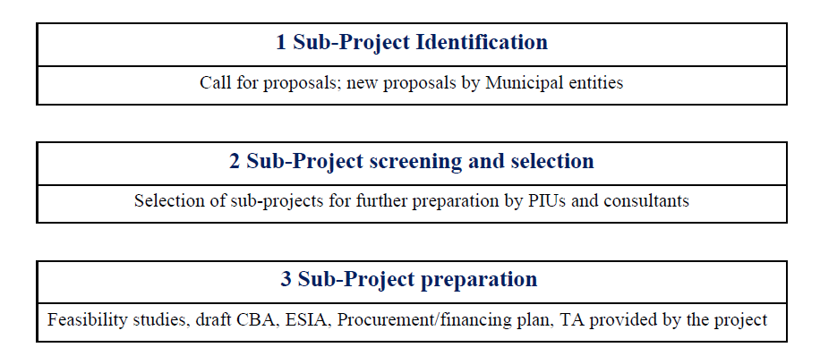
“Support to the Ministry of Infrastructure for the Ukraine Urban Public Transport Framework Loan Project”
3 Sub-Project cycle
3.1 Cabinet of Ministers of Ukraine Resolution No 70
The sub-project cycle will have as well to correspond to the Cabinet of Ministers of Ukraine Resolution No.70 “On preparation, implementation, monitoring and completion of economic and social development projects of Ukraine supported by IFIs”. The 6 main steps in the project cycle under the UPTP are presented in the illustration below:

Slide 15
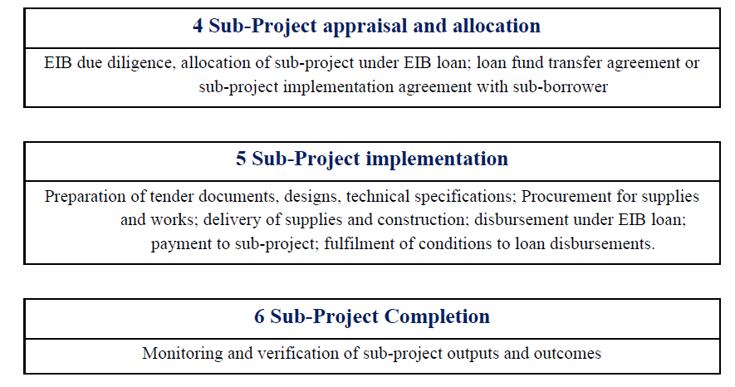
“Support to the Ministry of Infrastructure for the Ukraine Urban Public Transport Framework Loan Project”
3 Sub-Project cycle

Slide 16
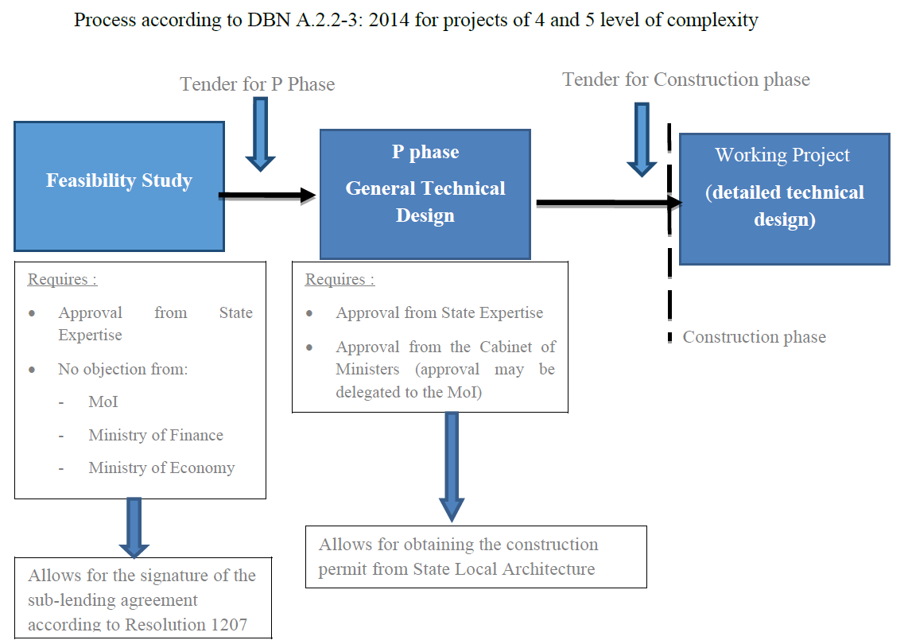
“Support to the Ministry of Infrastructure for the Ukraine Urban Public Transport Framework Loan Project”
3 Sub-Project cycle
In case of works

Slide 17
“Support to the Ministry of Infrastructure for the Ukraine Urban Public Transport Framework Loan Project”
3 Sub-Project cycle
3.2 the sub-projects eligibility
Each eligible Sub-Project with a total investment cost below € 25 million shall be selected by the Borrower and shall be subject to ex-post confirmation of eligibility by the Bank. The Borrower shall submit an Allocation Request in a form prescribed by the PPM.
Each eligible Sub-Project with a total investment cost of € 25 million or more but less than € 50 million shall be submitted ex-ante to the Bank for approval before disbursement of the Loan to the Borrower using a pro-forma prescribed by the PPM. The Bank shall have the right to request the Borrower to provide additional information. Partial or full appraisal of the Sub-Project may be undertaken by the Bank, if deemed necessary.
Each eligible Sub-Project with a total investment cost of € 50 million or above shall be treated as a separate loan and appraised separately by the Bank. Such Sub-Projects shall be subject to the Bank’s approval before disbursement of the Loan to the Borrower. The Borrower shall provide documentation as may be requested by the Bank at its discretion. A Sub-Project requiring separate appraisal may be subject to additional conditions to be agreed with the Borrower and, as applicable, the relevant Final Beneficiary.

Slide 18
“Support to the Ministry of Infrastructure for the Ukraine Urban Public Transport Framework Loan Project”
4 Data, Documents transmission and archiving policy
4.1 General
All correspondence of strategic importance within UPTP on behalf of the MoI shall be endorsed by the Project Coordinator or Project Manager, and on behalf of each PIU by the respective Head of PIU/ Sub-Project Manager.
All incoming documents under the UPTP shall be subject of obligatory registration. The registration shall be done by the office or assigned officer of MoI, PMSU or PIU, through attachment of an incoming reference number and making a relevant log in the incoming documents registers.
The incoming document shall be forwarded to the addressee. A copy of this document shall be filed in a specified folder, assigned for such type of documentation.
In the impossibility to identify the officer to whom the incoming document has been addressed, it shall be forwarded for consideration to the Project Manager, and in the case of a PIU to the Sub-Project Manager, for consequent decision and action.

Slide 19
“Support to the Ministry of Infrastructure for the Ukraine Urban Public Transport Framework Loan Project”
4 Data, Documents transmission and archiving policy
All outgoing documents shall be subject to registration in a special logbook, with attachment of an appropriate reference number in the office of the PMSU or PIU. In case the attachment is too big in terms of number of pages reference to location of the hardcopy shall be indicated.
4.2 Language
Documents, evidence, notices and communications provided or made by the UPTP stakeholders to the EIB shall be provided in the English language unless the original language of the document is not English, in which case the document shall be provided to the Bank in its original language together with an English translation thereof. The Bank can request a certified English translation.

Slide 20
“Support to the Ministry of Infrastructure for the Ukraine Urban Public Transport Framework Loan Project”
4 Data, Documents transmission and archiving policy
4.3 Soft copy Policy
Project related correspondence shall to the extent possible be carried out via electronic mail. Electronic correspondence within UPTP shall be considered official, as well as official hard-copy letter exchange, carried-out by post.
All official correspondence shall be carried out from one e-mail account/address (e.g. PMSU Office e-mail address/ PMSU Project Manager from MoI), while other personnel’s e-mail addresses shall be put in CC (copy), as need may occur.
For this purpose, each PIU creates and uses one general electronic mail address, or an existing e-mail address shall be used to this effect. The e-mail account should have no limitations on the number of addressees in one communication or limited capacity for attached files.

Slide 21
“Support to the Ministry of Infrastructure for the Ukraine Urban Public Transport Framework Loan Project”
4 Data, Documents transmission and archiving policy
4.3 Soft copy Policy
In communication with EIB, any such communication shall be sent to the PMSU Project Manager in CC, additionally in the event the letter shall concern procurement, it will be also CCed to the Procurement Specialist of PMSU, should that concern financial issues the e-mail will be also CCed to the Financial Management Specialist of PMSU etc.
In reply to communications from EIB, or other incoming electronic letter, the reply shall be directed to the original sender and a copy of the reply shall be sent to all officers CCed in the original letter.
All data in electronic form shall be kept on the dedicated PMSU server with a back-up copy created on a weekly basis.
4.4 Hard Copy, Filing and Archiving Policy
The PMSU Project coordinator and the PIU manager are responsible for establishing and adhering to filing and archival procedures.

Slide 22
“Support to the Ministry of Infrastructure for the Ukraine Urban Public Transport Framework Loan Project”
4 Data, Documents transmission and archiving policy
Along with electronic correspondence, exchange of hard-copy documents is allowed and shall be considered official.
The basic requirements to document flows are the following:
All documents shall be kept in hard (paper-based) copies, filed in folders/files. Prior to filing documents for storage, they must be stapled to avoid loss of their separate parts;
Documents shall be stored as to the category/transaction/operation they pertain to. In other words, documents pertaining to one transaction shall be filed in one folder;
Documents will be separated if they belong to different operations while kept in one file. This affords to promptly ascertain that all documents belonging to one operation are in place, as well as add new documents as need may occur.
In the event, the same document belongs to different operations, it will be copied and its copies shall be filed together with other documents within respective operations.

Slide 23
“Support to the Ministry of Infrastructure for the Ukraine Urban Public Transport Framework Loan Project”
4 Data, Documents transmission and archiving policy
In the case of impossibility to place the document in the relevant file (owing to its size); it will need to file a sheet of paper in the relevant place within the folder with a reference to the location of the documents original.
The term of document storage shall be established by current legislation and MoI’s internal rules of procedure, or those of relevant PIU, but not less than the period of UPTP implementation.
Working documents shall not be taken out of the office without Project Coordinator or PMSU Project Manager Authorisation;in the cases of a PIU without Director or Head of PIU consent.
All rough copies or spoilt documents will be subject to destruction through shredder.

Slide 24
“Support to the Ministry of Infrastructure for the Ukraine Urban Public Transport Framework Loan Project”
4 Data, Documents transmission and archiving policy
E-mail subject and Project reference Policy
In each communication, the “subject” line cannot be left empty and must be written in English and have the following format:
UPTP: name of city: bidding title: tender’s ref. #: estimated cost: action required, or UPTP: name of city: regarding: action required
The name of the tender and its reference number can be found in the approved Procurement Plan. In the “action required” there will be brief description as to actions required from the recipient, e.g. request for ‘no-objection’ to or review of bidding documents, bid evaluation reports or Procurement Plans.
.

Slide 25
“Support to the Ministry of Infrastructure for the Ukraine Urban Public Transport Framework Loan Project”
Questions and discussion

Slide 26
“Support to the Ministry of Infrastructure for the Ukraine Urban Public Transport Framework Loan Project”
THANK YOU

